Slide 1
Conditional Statements and Looping constructs

Slide 2
Frequently, a program needs to skip over some statements, execute a series of statements repetitively, or choose between alternate sets of statements to execute.
That is where control structures come in. A control structure directs the order of execution of the statements in a program.

Slide 3
While writing program(s), we almost always need the ability to check the condition and then change the course of program, the simplest way to do so is using if statement.
The if statement is how you perform decision-making. It allows for conditional execution of a statement or group of statements based on the value of an expression.

Slide 4
Introduction to the if Statement
If <expr>:
<statement>
<expr> is an expression evaluated in Boolean context.
<statement> is a valid Python statement, which must be indented.
If <expr> is true (evaluates to a value that is “truth”), then <statement> is executed. If <expr> is false, then <statement> is skipped over and not executed.
Note that the colon (:) following <expr> is required. Some programming languages require <expr> to be enclosed in parentheses, but Python does not.

Slide 5
If x>0:
print (‘x is positive’)
Here, the Boolean expression written after if is known as condition, and if Condition is True, then the statement written after, is executed.

Slide 6
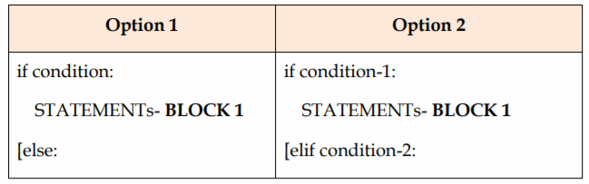
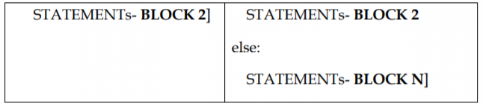
syntax of if statement
Statement with in [ ] bracket are optional.

Slide 7
In Option 1- if the condition is True (i.e. satisfied), the statement(s) written after if (i.e. STATEMENT-BLOCK 1) is executed, otherwise statement(s) written after else (i.e. STATEMENT-BLOCK 2) is executed.
Remember else clause is optional. If provided, in any situation, one of the two blocks get executed not both.
We can say that, “if” with “else” provides an alternative execution, as there are two possibilities and the condition determines which one gets executed.

Slide 8
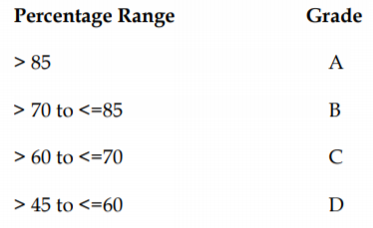
If there are more than two possibilities, such as based on percentage print grade of the student.
Then we need to chain the if statement(s). This is done using the 2nd option of if statement. Here, we have used ‘elif’ clause instead of “else”. elif combines if else- if else statements to one if elif …else. You may consider elif to be an abbreviation of else if. There is no limit to the number of “elif” clause used, but if there is an “else” clause also it has to be at the end.

Slide 9
Example for combining more than one condition:
if perc > 85:
print(“A”)
elif perc >70 and perc <=85: #alternative to this is if 70 <perc<85
print (“B”)
elif perc > 60 and perc <=70: #if 60 <=70
print (“C”)
elif perc >45 and perc <=60:
print (“D”)

Slide 10
In the chained conditions, each condition is checked in order if previous is False then next is checked, and so on. If one of them is True then corresponding block of statement(s) are executed and the statement ends i.e., control moves out of “if statement”. If none is true, then else block gets executed if provided. If more than one condition is true, then only the first true option block gets executed.
Statements terminated by colon are called compound statements. In any compound statement, there is no limit on how many statements can appear inside the body, but there has to be at least one. Indentation level is used to tell Python which statement (s) belongs to which block.

Slide 11
There is another way of writing a simple if else statement in Python. The complete simple if, can be written as:
Variable = variable 1 if condition else variable 2.
In above statement, on evaluation, if condition results into True then variable 1 is assigned to Variable otherwise variable 2 is assigned to Variable.

Slide 12
Example
>>> a =5
>>> b=10
>>> x = True
>>> y = False
>>>result = x if a < b else y
Will assign True to result

Slide 13
Sometimes, it is useful to have a body with no statements, in that case you can use pass statement. Pass statement does nothing.
Example
if condition:
pass

Slide 14
Nested Condition
It is possible to have a condition within another condition. Such conditions are known as Nested Condition.
Example
if x==y:
print (x, “and”, y, “are equal”)
else:
if x<y:
print(x, “is less than”, y)
else:
print(x, “is greater than”, y)
Here a complete if… else statement belongs to else part of outer if statement
Nested if

Slide 15
Note: The condition can be any Python expression (i.e. something that returns a value). Following values, when returned through expression are considered to be False:
None, Number Zero, A string of length zero, an empty collection

Slide 16
Looping Constructs
Loops are used to repeatedly execute the same code in a program. Python provides two types of looping constructs. While all the ways provide similar basic functionality, they differ in their syntax and condition checking time:
while
for

Slide 17
While statements
Syntax:
while expression:
statement(s)
All the statements indented by the same number of character spaces after a programming construct are considered to be part of a single block of code. Python uses indentation as its method of grouping statements.

Slide 18
The statement(s) will keep on executing till condition in while remains True; once the condition becomes False the loop will stop executing.
Example:
count = 0
while (count < 3):
count = count + 1
print("Hello world")

Slide 19
Example: a loop to print nos. from 1 to 10
i=1
while (i <=10):
print (i) i = i+1 #could be written as i+=1
The first statement initialized the variable (controlling loop) and then while evaluates the condition, which is True so the block of statements written next will be executed.
Last statement in the block ensures that, with every execution of loop, loop control variable moves near to the termination point. If this does not happen then the loop will keep on executing infinitely.

Slide 20
As soon as i becomes 11, condition in while will evaluate to False and this will terminate the loop.
Result produced by the loop will be:
1 2 3 4 5 6 7 8 9 10
As there is ‘ ’ after print i all the values will be printed in the same line

Slide 21
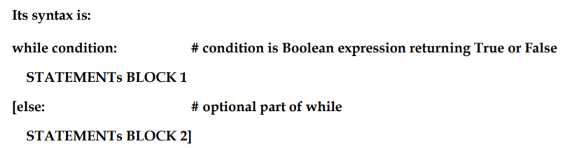
Using else statement with while loops
We can see that while looks like if statement. The statement(s) in BLOCK 1 keeps on executing till condition in while remains True; once the condition becomes False and if the else clause is written in while, then else will get executed. While loop may not execute even once, if the condition evaluates to false, initially, as the condition is tested before entering the loop.

Slide 22
Example
i=1
while (i <=10):
print(i)
i+ =1
else:
print() # will bring print control to next printing line
print (“coming out of loop”)
Will result into
1 2 3 4 5 6 7 8 9 10
coming out of loop

Slide 23
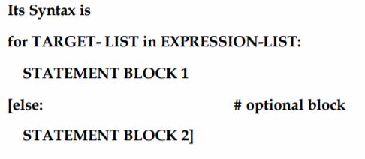
For statements

Slide 24
Example : loop to print value 1 to 10
for i in range (1, 11, 1):
print (i)
Execution of the loop will result into
1 2 3 4 5 6 7 8 9 10

Slide 25
The statement introduces a function range ( ), its syntax is
range(start, stop, [step]) # step is optional
range( ) generates a list of values starting from start till stop-1. Step if given is added to the value generated, to get next value in the list.

Slide 26
Understanding for statement:
i is the variable, which keeps on getting a value generated by range ( ) function, and the block of statement (s) are worked on for each value of i.
As the last value is assigned to i, the loop block is executed last time and control is returned to next statement.
If else is specified in for statement, then next statement executed will be else.
Now we can easily understand the result of for statement. range( ) generates a list from 1, 2, 3, 4, 5, …., 10 as the step mentioned is 1, i keeps on getting a value at a time, which is then printed on screen.

Slide 27
Apart from range( ) i (loop control variable) can take values from string, list, dictionary, etc.
Example
for letter in ‘Python’:
print (‘Current Letter’, letter)
else:
print (‘Coming out of loop’)
On execution, will produce the following:
Current Letter: P
Current Letter: y
Current Letter: t
Current Letter: h
Current Letter: o
Current Letter: n
Coming out of loop

Slide 28
Nested loop
A for statement can contain another for statement or while statement. Such statement form nested loop.
Example:
# to print table starting from 1 to specified no.
n=2
for i in range (1, n+1):
j=1
print (“Table to ”, i, “is as follows”)
while j <6:
print (i, “*”, j, “=”, i*j)
j=j+1
print()

Slide 29
Will produce the result:
Table to 1 is as follows
1 * 1 = 1
1 * 2 = 2
1 * 3 = 3
1 * 4 = 4
1 * 5 = 5
Table to 2 is as follows
2 * 1 = 2
2 * 2 = 4
2 * 3 = 6
2 * 4 = 8
2 * 5 = 10

Slide 30
Nesting a for loop within while loop can be seen in following example :
Example
i = 6
while i >= 0:
for j in range (1, i):
print (j)
print()
i=i-1
will result into
1 2 3 4 5
1 2 3 4
1 2 3
1 2
1

Slide 31
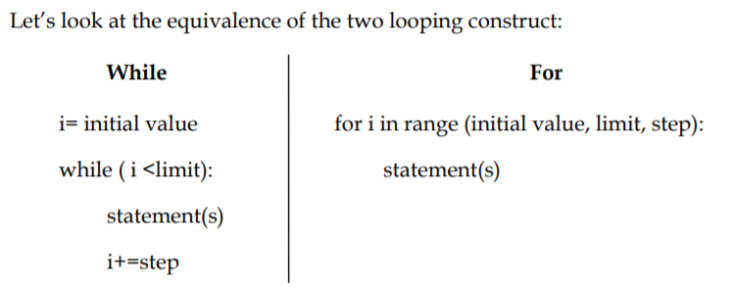

Slide 32
Break Statement
Break can be used to unconditionally jump out of the loop. It terminates the execution of the loop. Break can be used in while loop and for loop. Break is mostly required, when because of some external condition, we need to exit from a loop.
Example
for letter in ‘Python’:
if letter = = ‘h’:
break
print letter

Slide 33
will result into
P
Y
t

Slide 34
Continue Statement
This statement is used to tell Python to skip the rest of the statements of the current loop block and to move to next iteration, of the loop. Continue will return back the control to the start of the loop. This can also be used with both while and for statement.
Example
for letter in ‘Python’:
if letter == ‘h’:
continue
print letter

Slide 35
will result into
P
y
t
o
n

